Slide 1
UTO QA Team
Regression Testing- Automation using Selenium

Slide 2
Prerequisites
Mozilla Firefox installed https://www.mozilla.org/en-US/firefox/new/

Slide 3
Selenium
Automate Web tasks primarily browser based
Selenium history
Selenium 1.0
Selenium 2.0
Selenium has two main distributions :
Selenium IDE
Selenium Web driver

Slide 4
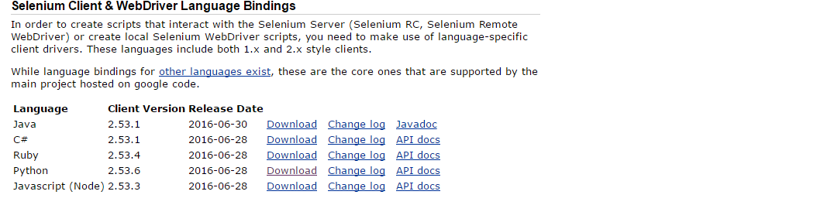
Selenium Webdriver
http://www.seleniumhq.org/download/

Slide 5
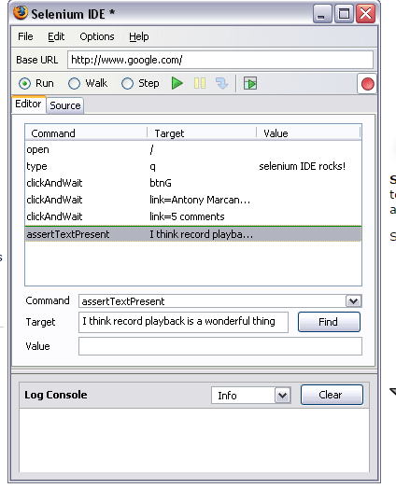
Selenium IDE

Slide 6
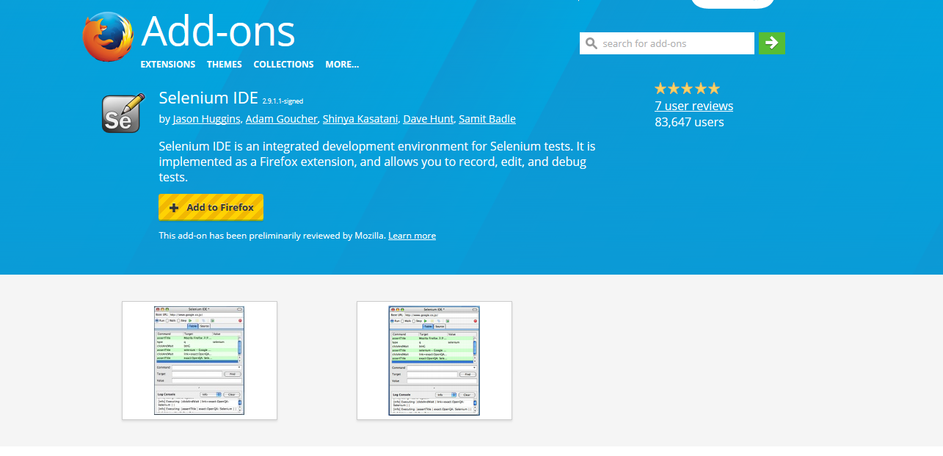
Install Selenium IDE and Extensions
Step-1: https://addons.mozilla.org/en-US/firefox/addon/selenium-ide/

Slide 7
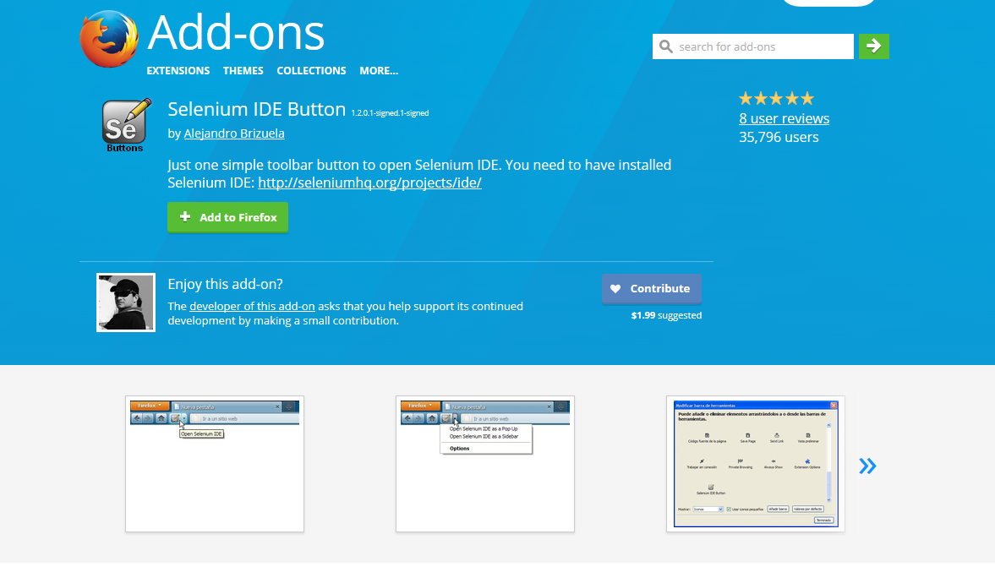
Step 2: https://addons.mozilla.org/en-US/firefox/addon/selenium-ide-button/

Slide 8
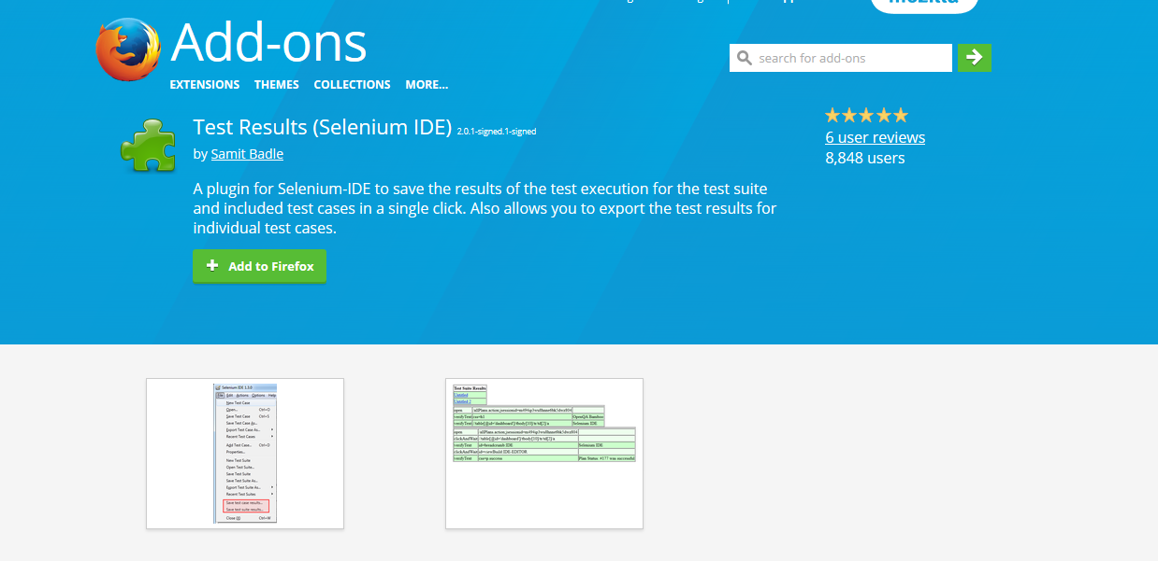
Step 3: https://addons.mozilla.org/en-US/firefox/addon/test-results-selenium-ide/?src=external-s1

Slide 9
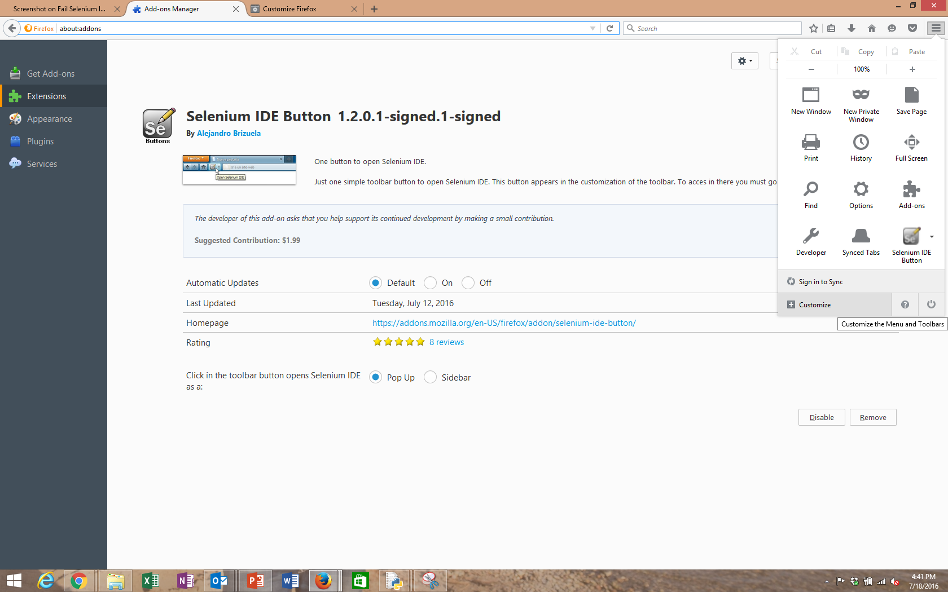
Tutorial 0: Opening Selenium IDE and Menu Options
Step 1: Open Firefox and click on customize

Slide 10
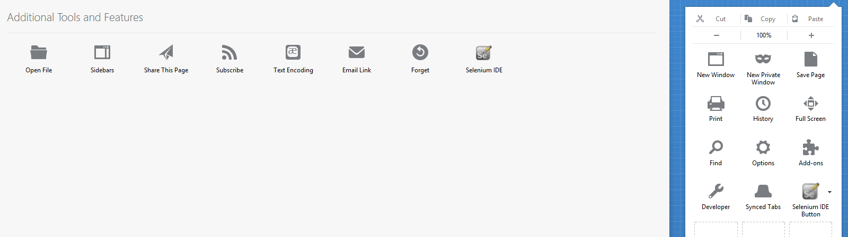
Step 2: Add selenium IDE button to the right menu box

Slide 11
Selenium Basic Operations
Record a script
Open new Tab in Firefox and click on selenium IDE button and start browsing the pages you want to automate.
Understanding the Recorded scripts
Editing and running scripts

